Slide 1

Walnut Way Northwestern Mutual
Ashvini Patel
Aaron Moriak
Thea Robinson

Slide 2
Northwestern Mutual
Northwestern Mutual is an American Financial services mutual organization
The financial security company provides consultation in wealth and asset income protection, education planning, and much more.

Slide 3
Walnut Way
Organizational goal: to be a catalyst in creating housing and economic opportunities for residents in Lindsay Heights
Founded in 2000 by Lindsay Heights residents.
Has a series of successful and innovative programs and initiatives addressing the neighborhood's most pressing economic, environmental, and health issues.

Slide 4
Partners involved
Data You Can Use
Help people access data and make it useful in improving community conditions.
Local Initiatives Support Corporation
LISC bridges the gap by offering the relationships and expertise to help community organizations attract the kinds of resources that allow them do their best work
Marquette University
University of Wisconsin- Milwaukee

Slide 5
Previous Meeting
Debrief about data sets that have been found
Given tasks to find data sets for the Lindsey Heights area
Collaborated all the findings
Created a google folder with all the information and datasets
Speaking with different partners about accessing data
Zilber

Slide 6
Northwestern Mutual- Walnut Way Data Dream Project
The Walnut Way proposal is centered around an initiative to increase home ownership in the Lindsay Heights neighborhood by providing training, capital, mentoring and services to help homeowners keep their houses. The goal is to improve the neighborhood and build wealth for residents.

Slide 7
Data Dream Questions and Outline
What could happen if residents in the neighborhood had the tools and resources necessary to increase home ownership and to sustain existing home ownership?
Project Scope: Visualize and analyze data trends in home ownership, rental, foreclosure, and evictions. If possible, include trends in homeownership tools and resources residents are using. Also, historic homes vs new construction, costs associated with bringing historic homes up to legal compliance, and rental rates relative to the city.

Slide 8
Data Dream Questions and Outline
Traditional funding models don’t work for Lindsay Heights because of low income levels. What would need to be true in order to have a non-traditional underwriting approach and/or alternative qualification method to financing models for home ownership?
Project Scope: Visualize and analyze data trends in income levels, economic markers, home ownership, mortgages, and other lending. If possible, include trends in other financing products, underwriting, and banking.

Slide 9
Data Dream Questions and Outline
Why haven’t property values increased in Lindsay Heights in the last 10-15 years relative to the market?
Project Scope: Visualize and analyze data trends in property value vs surrounding neighborhoods, Milwaukee, and other neighborhoods of similar demographics. If possible, include trends in salaries, wealth, lending, taxes, and other resident’s assets.

Slide 10
Project Timeline
Planning Phase (Dec 2019 – Jan 2020):
Gather and commit NM, Marquette, and UW Milwaukee resources
Determine exact sources of existing data
Determine scope and methodologies to collect new data

Slide 11
Project Timeline
Implementation Phase (Feb 2020 – April 2020)
Collect existing data
Conduct collection of new data
Gather, assemble, and analyze all data sets
Develop visualization, storytelling, and summary

Slide 12
Project Timeline
Handoff (April 2020)
Present and handoff results to Walnut Way and LISC
Walnut Way and LISC will enter an economic and housing development planning process in April
The information will be handed to Walnut Way and they will have complete access to all the data
Attempt to make certain data open to public with a dashboard through a third party

Slide 13
Data Variables
Property Variables
Income tax
Property value
Property tax
Real estate tax
Property sales
Lot prices
Property mortgages
Other Variables
Schools
Criminal activity
Other Variables to consider
Lots already occupied
Lot sizes
Neighboring residential areas

Slide 14
Data Sets
Crime Data for Zip code 53206 and 53205
Data for Delinquent Real Estate Tax Accounts for zip codes 53205 and 53206
Data for Delinquent Personal Property Tax Accounts for zip codes 5305 and 53206
Data for Master Property File
And more!

Slide 15
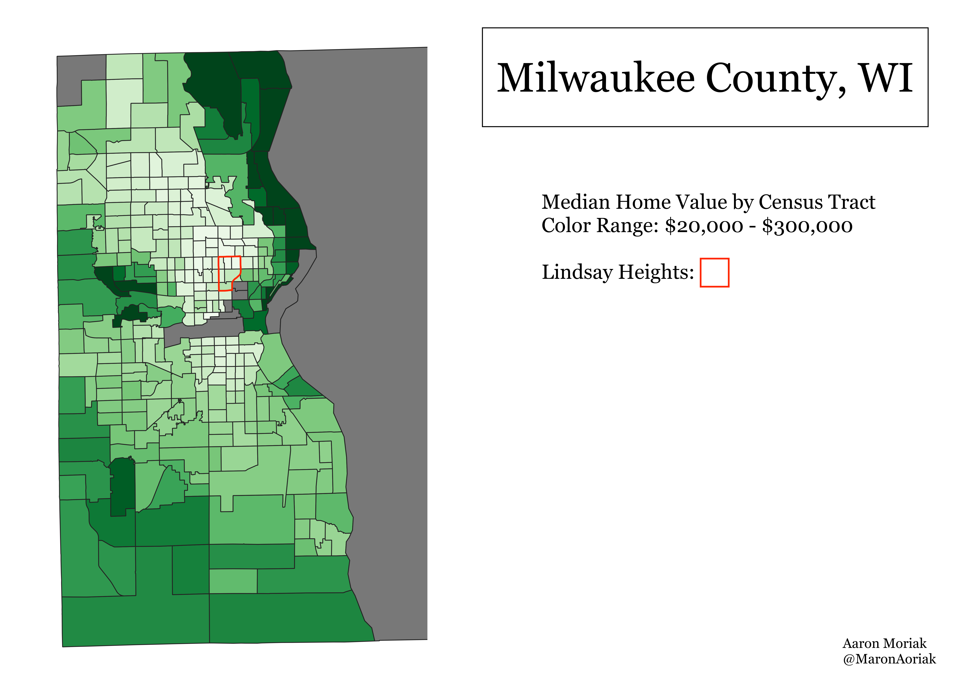
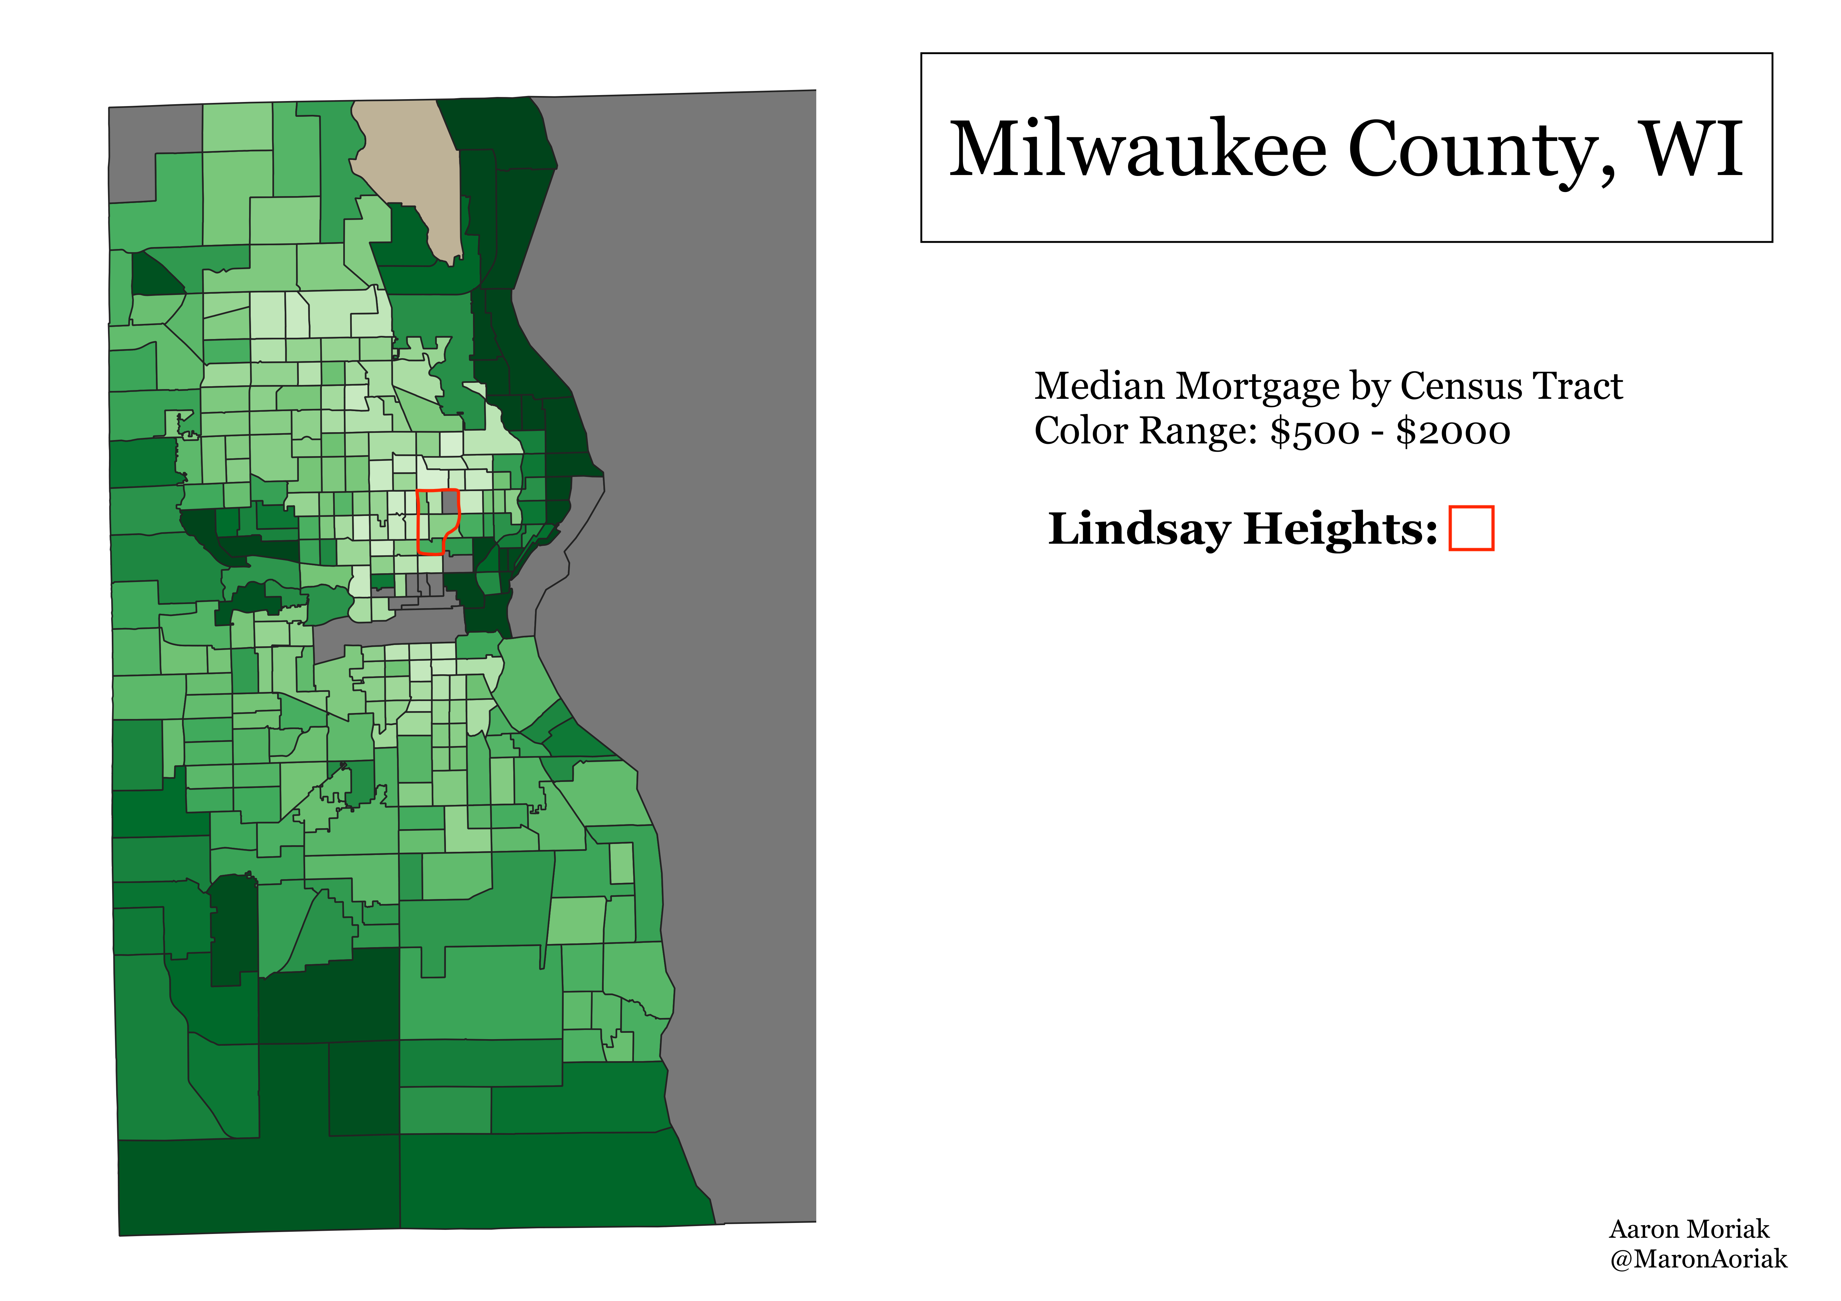
Data Visualization

